Slide 1
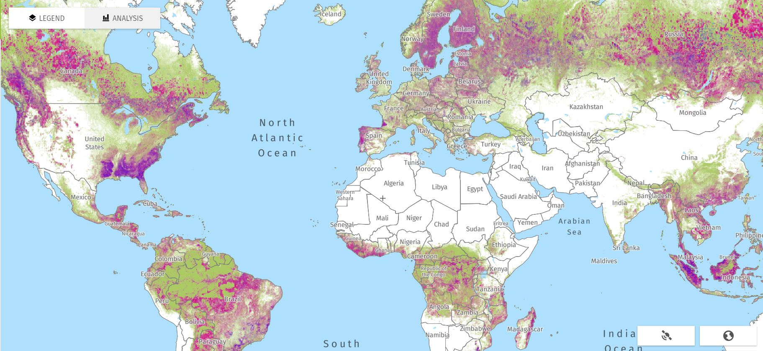
Atmospheric Carbon Dioxide Equilibrium

Slide 2
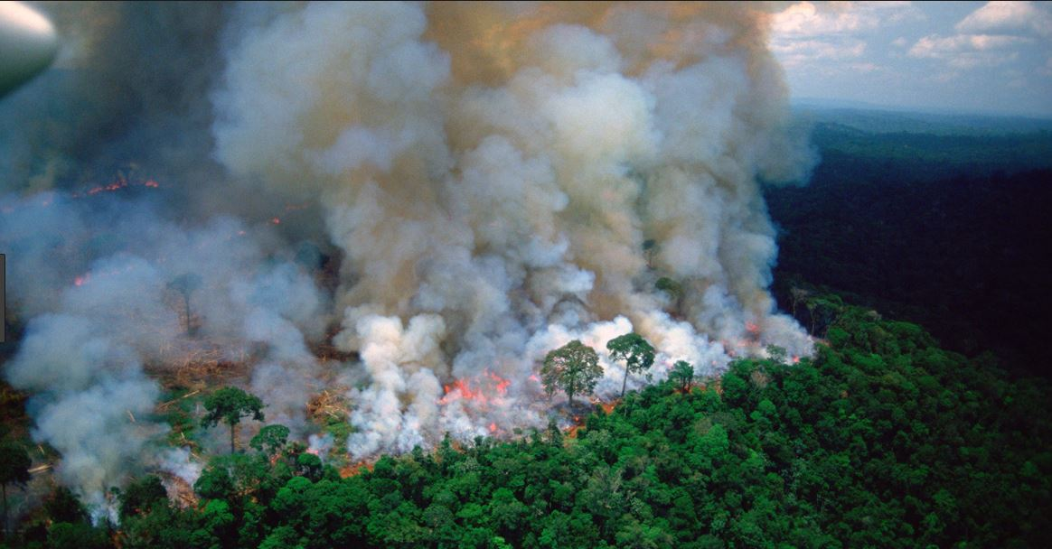
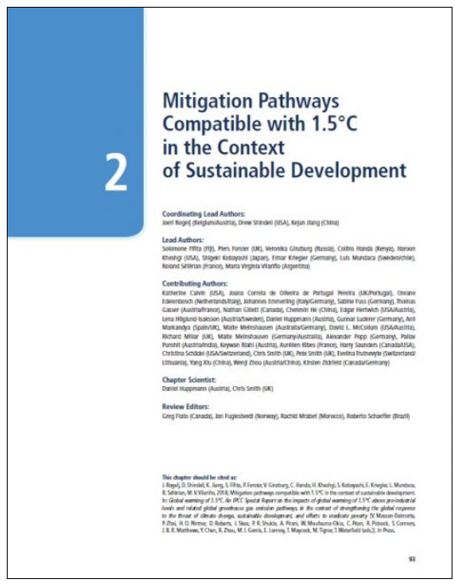
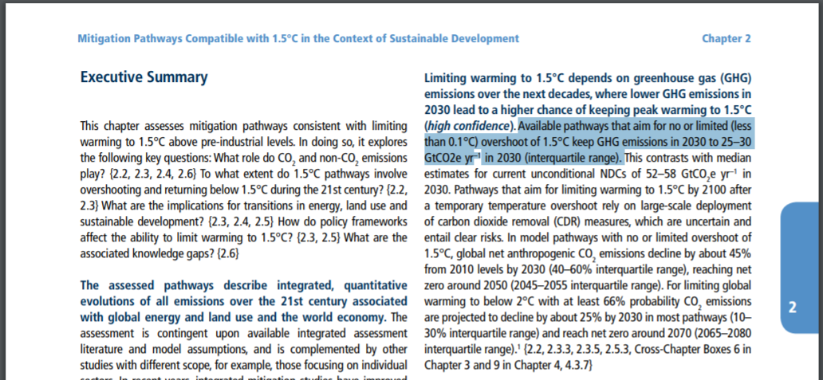
SR1.5 IPCC 2019

Slide 3
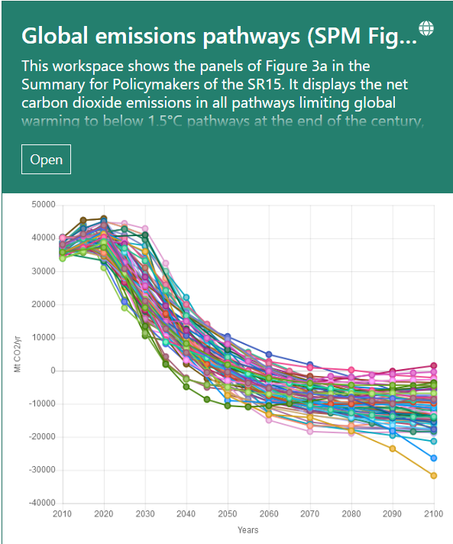
IPCC Simulations
These simulations have not and will not predict anything.
There are no bourdary conditions at 20 billion tons of natural emissions.
The simulation goes to below zero which is not possible.

Slide 4
IPCC
SR 1.5 Spring 2019 Page 95 right hand column toward the top says “Available pathways that aim for no or limited (less than 0.1°C) overshoot of 1.5°C keep GHG emissions in 2030 to 25–30 GtCO2e yr−1 in 2030 (interquartile range)”.
To anyone this looks like an equilibrium statement.
  Further creditability comes from Dr. Jim Skea press conference last October where he said “ We need to reduce human emissions by 45%” This gets us to 30 GTCO2yr-1.
  Our natural emissions are 20 GTCO2yr-1. Human 17 GTCO2yr-1. 45% of 17 gets us to 30.

Slide 5
IPCC responce
I sent this email 4 times to the authors of Chapter 2. “My question is simple: How was the number of 25-30 GtCO2e yr−1 arrived at? I calculated the current photosynthesis consumption is 12 GtCO2e yr−1. This is the true equilibrium”.
Here is their response.
  Dear Dave, Thank you very much for your question on the assessment of quantitative pathways in the SR15. The statement is taken from Table 2.4, bottom section, third row, first column, rounded to multiples of 5. The assessment in this table is based on the ensemble of quantitative pathways compiled by the IAMC and IIASA for the IPCC SR15 process (https://doi.org/10.22022/SR15/08-2018.15429). The Python script for preparing this table is available under an open-source license at https://data.ene.iiasa.ac.at/sr15_scenario_analysis/assessment/sr15_2.3.3_global_emissions_statistics.html (see https://doi.org/10.22022/SR15/08-2018.15428 for the scientific reference of the assessment notebooks).
  Neither the statement nor the table does make any assertion about an equilibrium, it is merely an assessment of the pathways at a specific point in time. I do hope that this clarifies your request.
  Best regards,
  Daniel
  Dr. Daniel Huppmann
  Research Scholar, Energy Program (ENE)
  International Institute for Applied Systems Analysis (IIASA) Schlossplatz 1, A-2361 Laxenburg, Austria huppmann@iiasa.ac.at
  +43(0) 2236 807-572
  www.iiasa.ac.at/staff/huppmann

Slide 6
Equilibrium Calculation
Total forest hectares in Northern Hemisphere (NH) is about 2050 million. So the most photosynthesis from vegetation in the NH could be is 1050(50% of 2050HA)*0.25 + 615(30%)*1.5+410(20%)*5= 3.2 billion tons of consumption.
Increased biomass from the Earth warming and higher troposphere carbon dioxide concentrations do not produce enough photosynthesis to offset the massive deforestation around the globe. I have studied photosynthesis for three years now. This is not what brings down the oscillation at Mauna Loa.
The Southern Hemisphere (SH) has much less land; however, it has rain forests. The Amazon Rain Forest has switched to become a massive CO₂ producer and oxygen sink. However, the decay contribution from the Amazon is 10-15 billion more tons annually. Anthropogenic forest degradation and biomass burning (forest fires and agricultural burning) also represent relevant contributions. The over two billion acres remaining cancel out any other land and ocean based photosynthesis in the SH. This is because of the switching to an oxygen sink and carbon dioxide emitter.
The total worldwide is 3.2+6=9.2 billion tons per year.

Slide 7
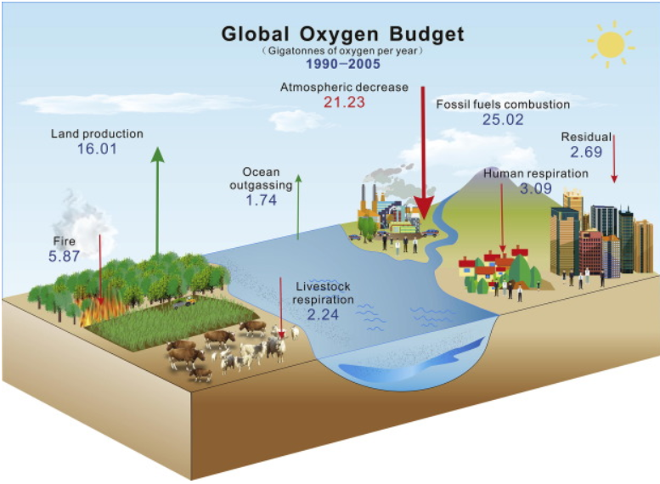
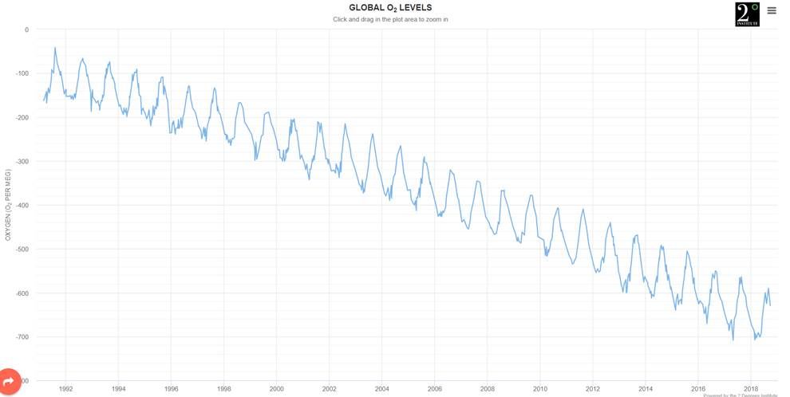
Oxygen Levels
We need 17.7 GTyr⁻¹ of oxygen for life on earth. The oxygen levels are decreasing so the photosynthesis must be less than that. The total oxygen needed is 17.7 GTyr⁻¹. The natural emissions are more than this. Therefore, we cannot lower atmospheric carbon dioxide by working on emissions. It will not work and it is a waste of resources. Planting 200 billion trees and shrubs and stopping non-sustainable deforestation is the only way to reduce atmospheric carbon dioxide.

Slide 8
Increase Photosynthesis to lower CO₂ by 2031
We can keep doing what we are doing and don’t need to do anymore. Refocus on planting trees and shrubs is what’s needed. Native ones that produce oxygen year around are preferred. This document is revenue plus.
Put pressure on Brazil and other Amazon rain-forest countries to stop deforestation ASAP. Also stop the biomass burning that puts 300 million tons of carbon dioxide into the atmosphere each year. This has caused 50 ppm of the recent rise in atmospheric carbon dioxide concentration. Then after 10 years finish burning what is needed at 10% per year for 10 years.
Provide space where public can come and plant trees and shrubs. All government-owned lands. Very small cost. Need website with document for each planting area.
Plant shrubs in all freeway medians and sides. This is revenue plus in a two-year cycle. Plant native shrubs at a minimal spacing so all light is used in photosynthesis. This will take in 1 ton of CO₂ emissions per acre per year right at the source. The space would not need to be mowed every week in the summer.
Get schools involved and planting massive number of trees and shrubs. In their property and the government property as in 1 above.
Parks can add trees and shrubs.
Tax incentive for business to plant trees and shrubs. Flat roofs which can structurally handle dirt can plant shrubs at minimum spacing and water using drip irrigation. “Green roofs”
Wild fire attention. Get a retainer for the Jet plane and use it from the start on any wild fire.

Slide 9
Dr. Tom Crowther
Restoring forests as a means to many ends
Science 05 Jul 2019:
Vol. 365, Issue 6448, pp. 24-25
DOI: 10.1126/science.aax9539
https://www.cnn.com/2019/07/04/world/forests-capture-two-thirds-of-carbon-emissions-scn-intl/index.html?utm_source=CNN+Five+Things&utm_campaign=182ed9adaf-EMAIL_CAMPAIGN_2019_07_04_01_00&utm_medium=email&utm_term=0_6da287d761-182ed9adaf-87728345

Slide 10
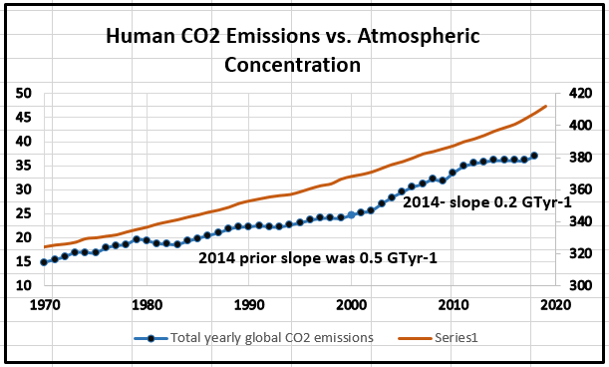
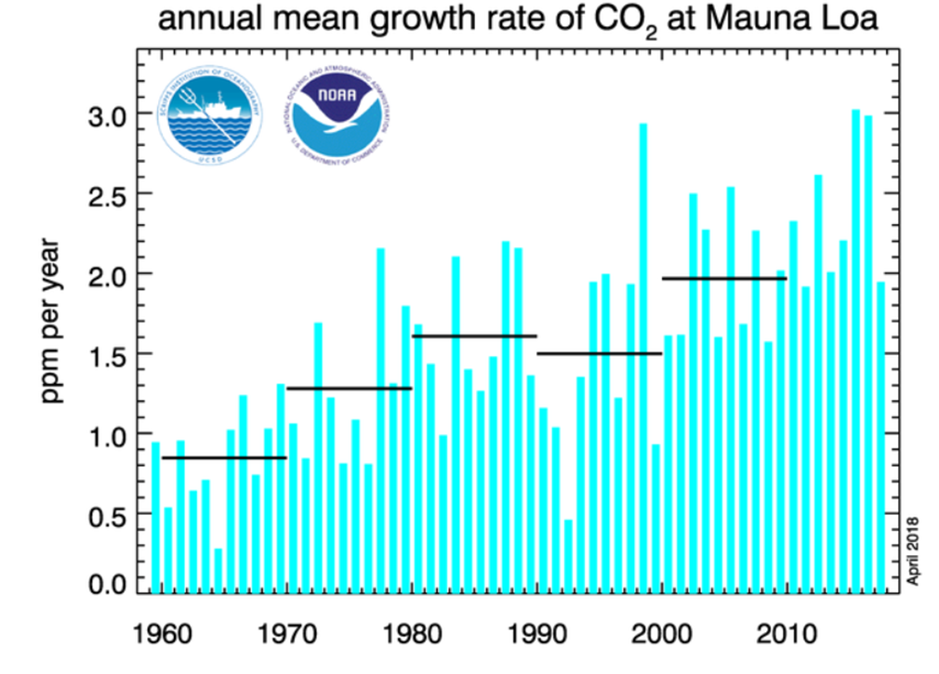
Anything we do with CO₂ emissions has had and will have no effect to lower CO₂. Emissions growth has slowed. However Atmospheric CO2 is increasing. The rate of rise is increasing. Increase photosynthesis is the only way.

Slide 11
