Slide 1



04/05/2023
Plenary address
IESCEE2023
The Essential Role of Photosynthesis in Defining Net Zero Carbon Dioxide
Emissions for Equilibrium Calculations
Professor Dave White, Henry Ealy and Katherine Martin
1Chemical Engineer with Masters Level study in Statistics, Climate Change Truth Inc. USA
2Head of Energetic Health Institute and Operation Phoenix Rising, USA
3Research assistant in research department for Climate Change Truth, USA

Slide 2
Agenda
Agenda
  I-Atmospheric CO₂ is not an emissions issue
  II-Ocean not a sink for Atmospheric Carbon Dioxide
  III-Sea Level Rise is 1.4 mmyr⁻¹ and not accelerating
  IV-Southeast USA storms cause and solution.
  Summary

Slide 3
I-Atmospheric CO₂ is not an emissions issue
Follow the data
Global carbon atlas.
Why its not our emissions
Where we are
Mauna Loa CO₂ Growth Rate
Where we are going
Future
Photosynthesis issues
Correct solution for Atmospheric CO₂ with results!
Global Warming Potential

Slide 4
Follow the data Not an Agenda
Use all the data- don’t cherry pick
See what the data says. Perform statistical analysis.
All models much be verified with actual data.
This presentation is the result of following the data.
Nature Climate Change and AMS Journals are “woke” and should not be used or cared about.
Predatory journal lists are lies!
All scientists must keep from a scientific belief system
We must keep our minds open to new science.

Slide 5
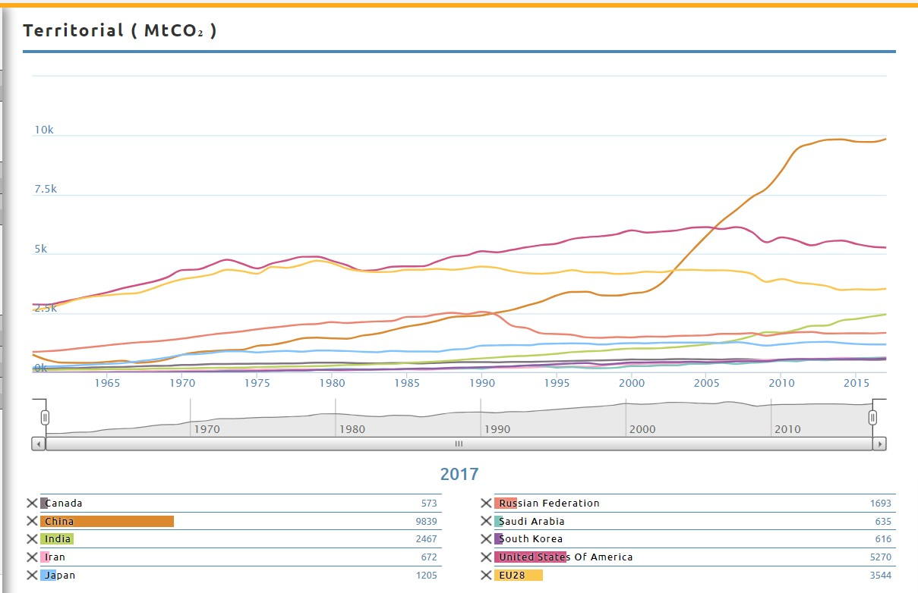
Global Carbon Atlas
USA 2006: 6131 MtCO₂ and in 2018: 5270 MtCO₂ --a 16%
decrease of CO₂.
Europe 1990: 4479 MtCO₂ and in 2018: 3544 MtCO₂ --a 21% decrease of CO₂.

Slide 6
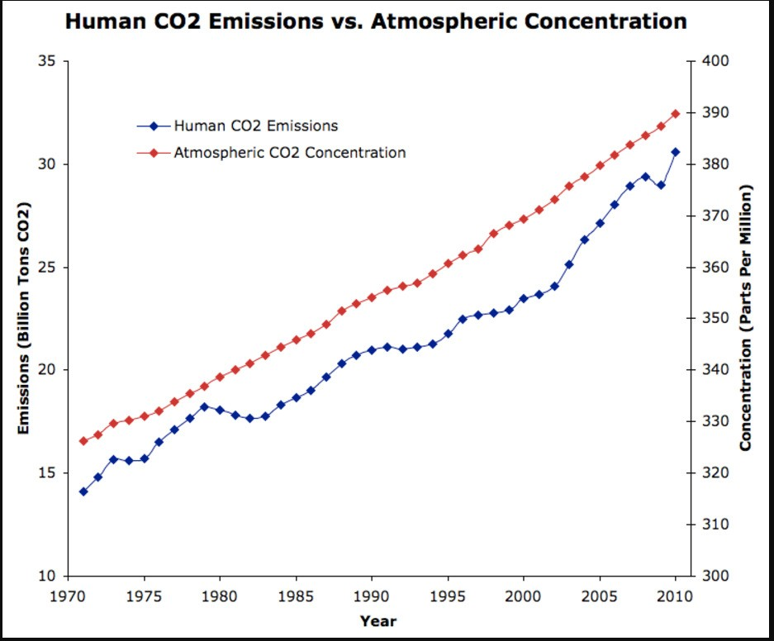
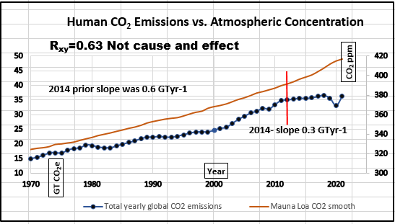
After spending $2.8 trillion we have:
Where we are
2008 r_{xy}=0.87 2023 r_{xy}=0.63
We have had mostly lower fossil fuel emissions since 2014. Massive deforestation continues!

Slide 7
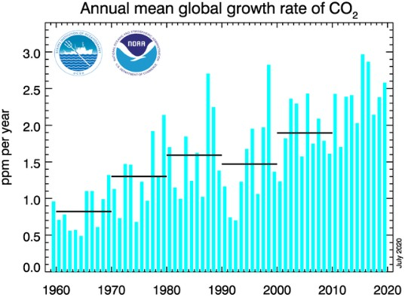
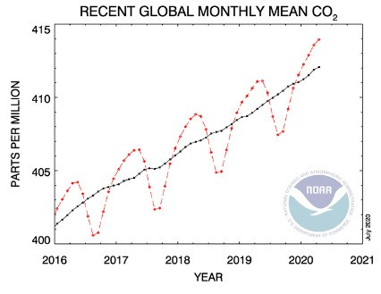
Mauna Loa CO₂ Growth Rate
Annual mean global CO₂ growth rate in increasing.

Slide 8
Where we are going
Facts
  Minimum residence time 150 years. Was 5 years
  Most work is on carbon emission reduction
  Reforestation efforts in China, Pakistan, India and North America ongoing.
  Atmospheric CO₂ is “Extra” that is not consumed in photosynthesis
Assumptions
  Keep current carbon emissions level at 35 billion metric tons annually.
    Decreases of carbon emissions will be offset by increases in population
  Atmospheric CO₂ stays the same slope.
  At 100 years no more oil so carbon dioxide emissions drop by 30%

Slide 9
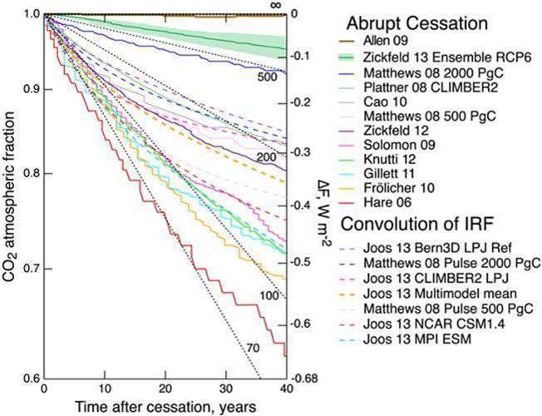
Average Residence Time of Atmospheric CO₂
Residence Time (Years) | Author | Year
>700 | Allen | 2009
610 | Zickfeld | 2013
500 | Matthews | 2008
300 | Plattner | 2008
270 | Cao | 2010
230 | Zickfeld | 2012
220 | Solomon | 2012
220 | Knutti | 2012
210 | Gillett | 2011
180 | Frolicher | 2010
150 | Hare | 2006
Unrealized Global Temperature Increase: Implications of Current Uncertainties, Schwartz, S. E. J. Geophys. Res. , 2018, doi: 10.1002/2017JD028121.

Slide 10
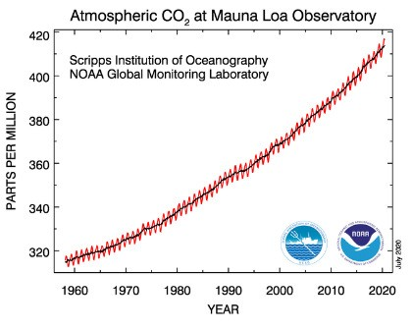
Residence Time
Another way to look at residence time is a signature from past events, which lowered CO₂ emissions.
Oil embargo in the 1970’s
Multiple recessions
Worldwide recession in 2009.
COVID-19 pandemic.
You can clearly see no signature from these events.
Netflix watch “Kiss the ground” movie explains even
if we stopped all CO₂ emissions atmospheric CO₂
will not lower.

Slide 11
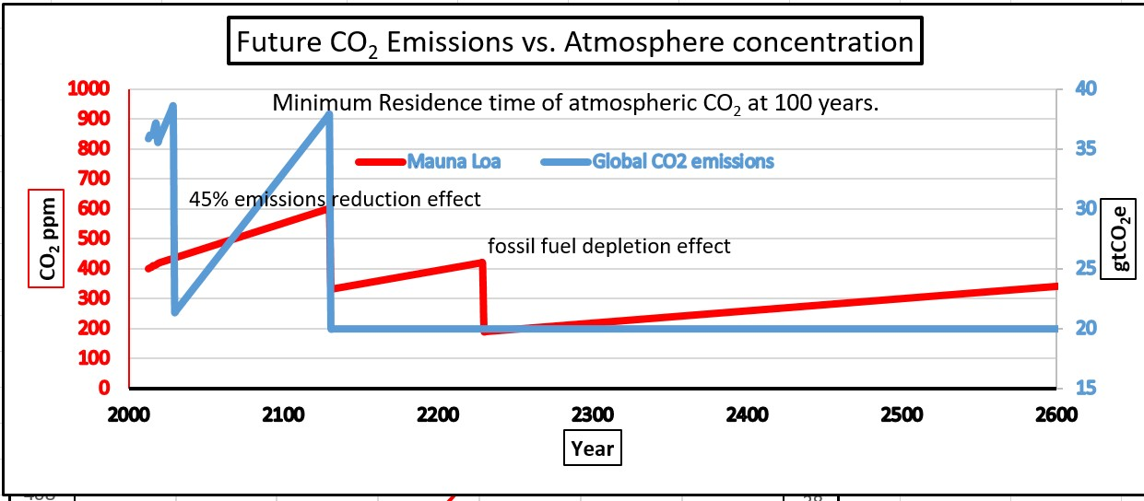
Future with residence time 100 years
CO₂ emissions correlation shrinks with passing of time.
Goes to zero at 580 ppm, Year 2060

Slide 12
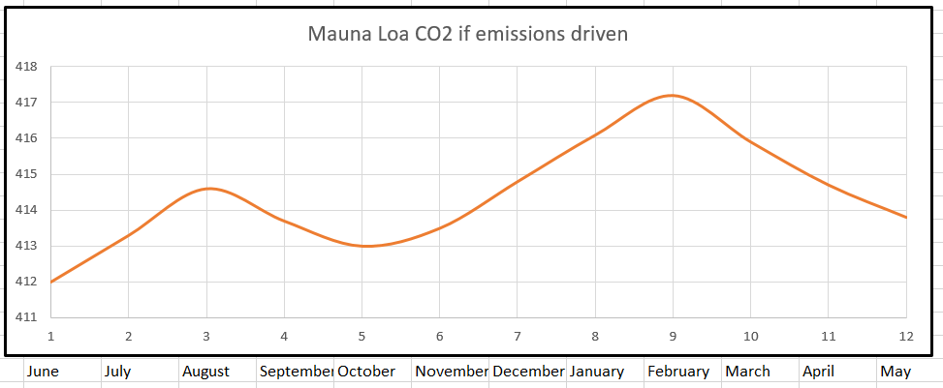
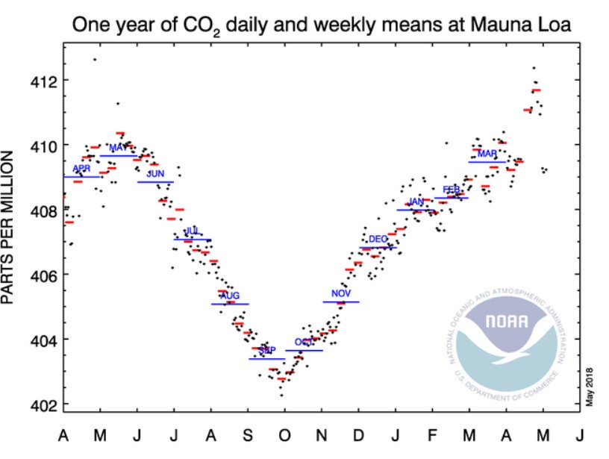
Why its not our emissions
90% of People live in Northern Hemisphere
90% of our emissions looks like this.
World Population by latitude
Population by SEDAC Data Access
40,000,000.00
35,000,000.00
Mauna Loa cycle for carbon dioxide
30,000,000.00
25,000,000.00
20,000,000.00
15,000,000.00
Population by Latutude
10,000,000.00
South Pole
5,000,000.00
0.00
North Pole
-90-80-70-60-50-40-30-20-10 0 10 20 30 40 50 60 70 80 90

Slide 13
Why residence time is increasing.
30-fold average residence time Increase 5›150 years.
Northern Hemisphere forests consume only 2.6 gtyr⁻¹ (2.6 billion tons per year) of carbon dioxide.
All tropical forests in the Southern Hemisphere have switched to become oxygen consumers and carbon dioxide producers.
We have a five-times increase in emissions of CO₂ mainly due to fossil fuel burning.
We have a 97% decrease in photosynthesis consumption of carbon dioxide. Due to massive non-sustainable deforestation.
The diffusion of CO₂ in the troposphere is toward the exosphere!
What Photosynthesis could be 55 ppm?

Slide 14
Photosynthesis issues
City sprawl is 1 billion tons lost CO₂ consumption annually
IPPC forestry estimates 2-3 billion tons lost CO₂ consumption annually from bio-mass burning.
Deforestation of 30 million acers annually in Amazon Rain-forest is 90 million tons lost CO₂ consumption. Total of 60 billion tons lost since 1950.
More than 300 billion tons lost CO₂ consumption annually from Amazon Rain-forest switching. 19x our emissions output.

Slide 15
Photosynthesis issues
The World Economic Forum has rightly said that we need
to plant 1 trillion trees, which will—in just ten years--drain the atmosphere quickly by increasing the consumption of
CO₂ (by 30 gt to 100 gtyr⁻¹).
35 billion tons of human emissions,3 billion are deforestation issues. The switch over of the amazon to an oxygen sink and carbon dioxide producer is 15 billion tons of unaccounted for CO₂ annually.

Slide 16
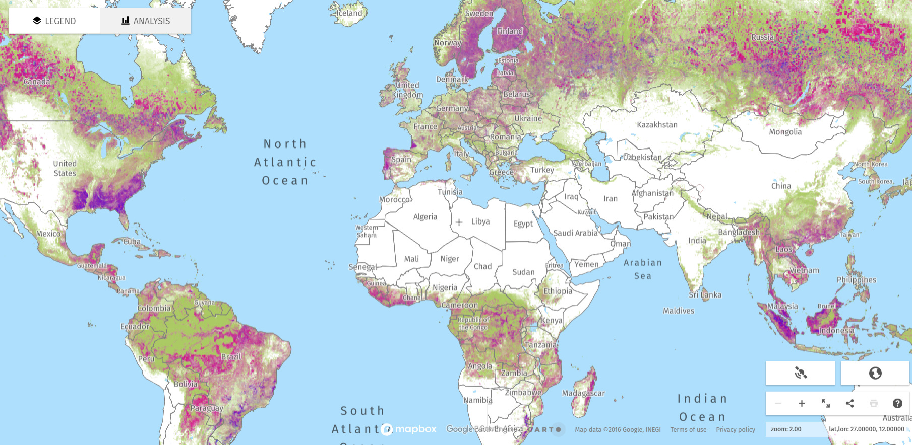
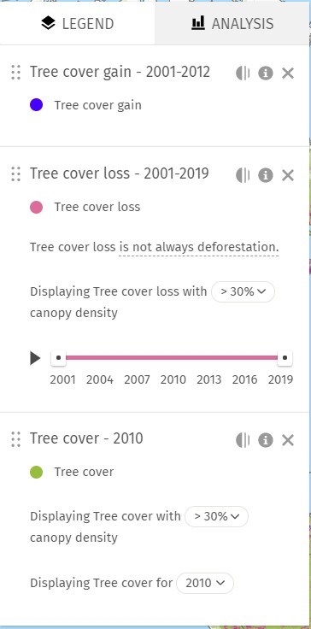
globalforestwatch.org/map
All plants and trees transfer 40-70% of carbon from photosynthesis
back into the ground!

Slide 17
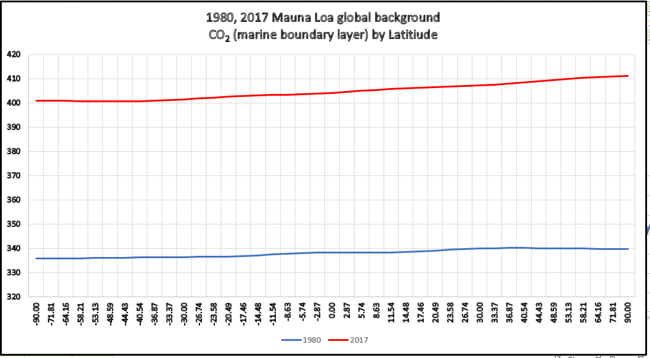
Atmospheric CO₂ by latitude
CO_{²} mixed by atmospheric winds.
Courtesy Pieter Tans Mauna Loa

Slide 18
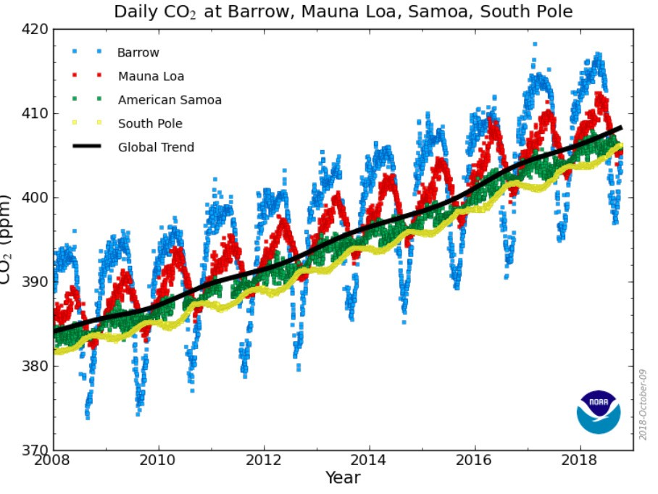
Mauna Loa harmonic trend
Strong yellow line at south pole

Slide 19
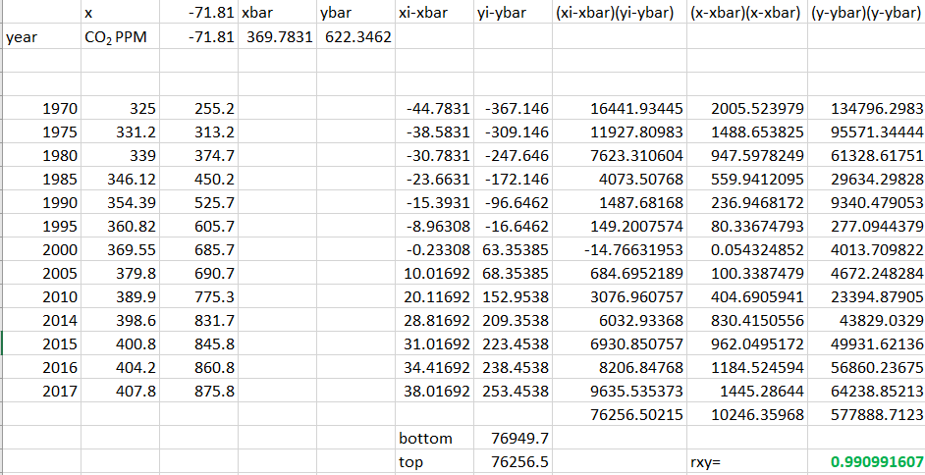
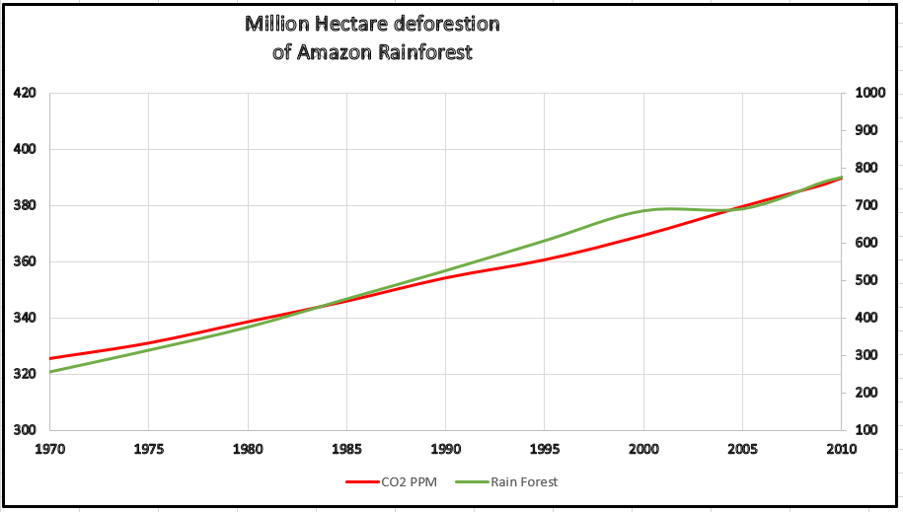
Amazon Rain-Forest
r_{xy}=0.99
CO₂ Emissions correlation 363, Rain-forest photosynthesis lost 55 ppm.

Slide 20
Amazon Rain-forest
2 Billion acres deforested since 1950.
1950 start deforestation
1957 Atmospheric Carbon Dioxide started current increase 1970’s trees and plants toppling over.
Burning of bio-mass each acre causes minimum 1 billion CO₂ release annually (6 months). The massive release caused plants to grow to fast causing toppling and massive decay.

Slide 21
Amazon Rain-forest
1990’s Changeover to oxygen sink and carbon dioxide producer.
Massive decay causing the rain-forest to change to an oxygen
sink and carbon dioxide producer.
One billion annual tons of carbon dioxide from biomass burning.
60 billion tons annual CO₂ consumption lost from deforestation.
300-400 billion tons annual CO₂ consumption loss from the switch over.
10-15 billion tons carbon dioxide emissions from decay per annum
We have lost 20%+ of Earths Oxygen production.

Slide 22
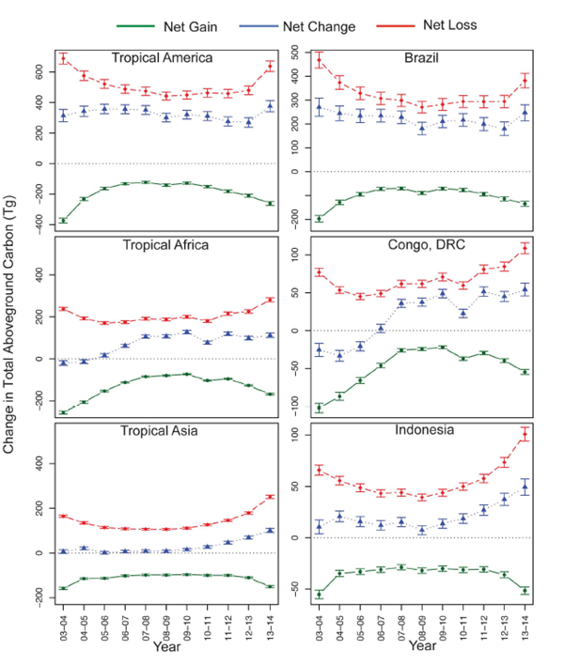
forests
1990’s Changeover to oxygen sink and carbon dioxide producer.
Massive decay causing the southern rain-forests to change to an
oxygen sink and carbon dioxide producer.
Blue line is difference between CO2 emitter or CO2 consumer.
We have lost 20%+ of Earths Oxygen production.

Slide 23
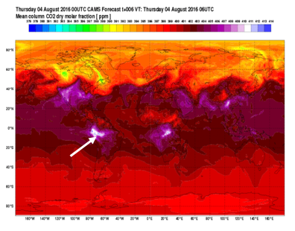
Amazon Rainforest effect on carbon dioxide
Amazon switching.

Slide 24
Loss of oxygen production worldwide
The Amazon Rainforest deforestation is a 0.98 cause
and effect to the reduction of oxygen since 1957.
The oxygen loss cycles just like the carbon dioxide rise.

Slide 25
Correct solution for Atmospheric CO₂
Moratorium on Rain-forest deforestation starting now! All nations need to put pressure on Brazil and all south America to stop this. Not one more acre.
Plant native trees and shrubs all over the world. 16+ billion new in 2019-2021. Increase Photosynthesis.
Stop deforestation in India and everywhere which is not sustainable.

Slide 26
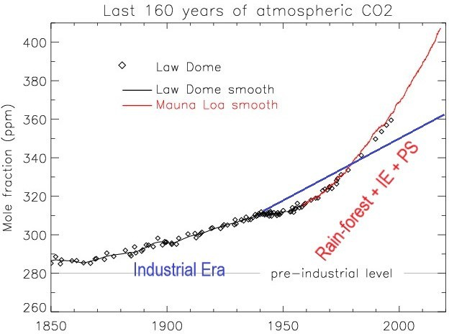
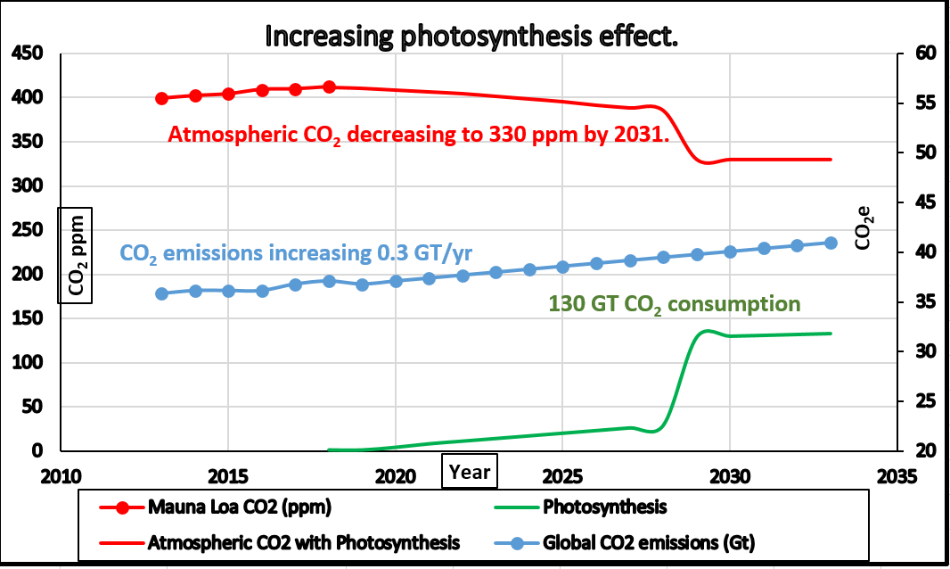
New Paradigm
We have worked on Carbon Dioxide Emissions.
Lets work on Photosynthesis. Atmospheric CO₂ decrease by 2031.
Drain atmospheric C0₂ like a bathtub.

Slide 27
Planting Ideas
Provide space where public can come and plant trees and shrubs. All government-owned lands. Very small cost. Need website with document for each planting area.
Plant shrubs in all freeway medians and sides. This is revenue plus. Plant
native shrubs at a minimal spacing so all light is used in photosynthesis. This will take in 1 ton of CO₂ emissions per acre per year right at the source. The space would not need to be mowed every week in the summer.
Get schools involved and planting massive number of trees and shrubs. In
their property and the government property as in 1 above.
Parks can add trees and shrubs.
Tax incentive for business to plant trees and shrubs. Flat roofs which can structurally handle dirt can plant shrubs at minimum spacing and water using drip irrigation.
Wild fire attention. Get a retainer for the Jet plane and use it from the start
on any wild fire.
This all government policy document is on the home page of cctruth.org

Slide 28
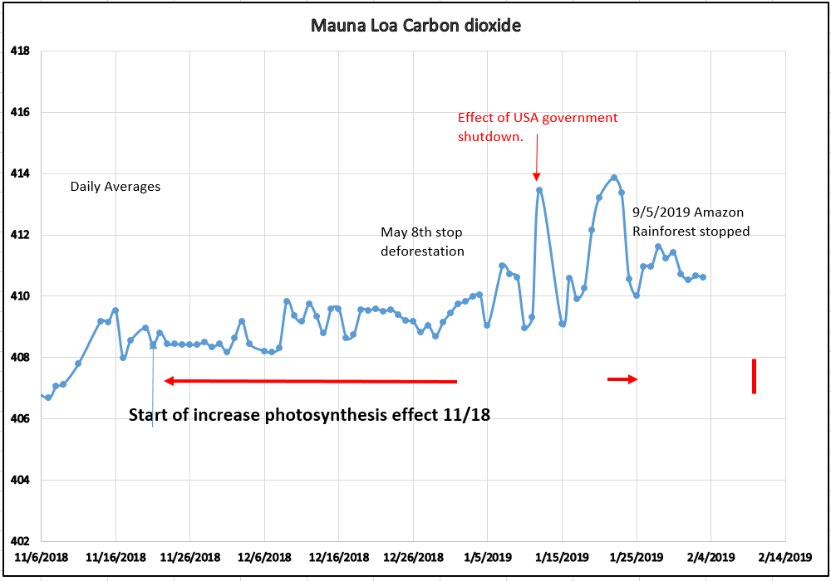
Results
With more than 1 billion trees planted
and Indian Rain forest stopped deforestation.
Atmospheric CO₂ went “flat” for the first time!
Period of 1 month December 2019
In 2020 more than 12 billion trees and one rainforest stopped. Expect similar or longer flat period. Also this year minimum was Lower than normal (407.75-408.25)

Slide 29
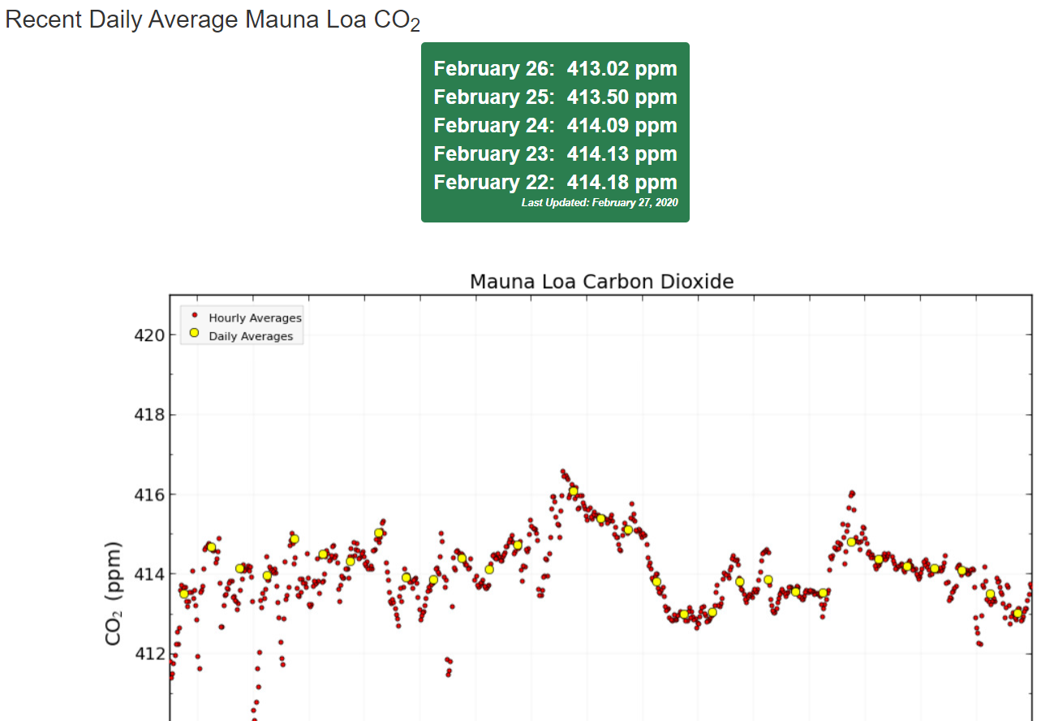
Mauna Loa 2020
https://theprint.in/world/pakistan-plans-to-plant-10-billion-trees-by-2023-to-restore-forest-cover/569129/
https://www.cbsnews.com/news/climate-change-india-plants-220-million-trees-in-a-single-day-to-save-the-planet/
https://www.abc.net.au/news/2019-10-17/green-walls-in-china-and-africa-keeping-deserts-at-bay/11602796 80 billion trees planned!
https://www.aljazeera.com/videos/2020/1/23/world-economic-forum-leaders-pledge-to-plant-1-trillion-trees

Slide 30
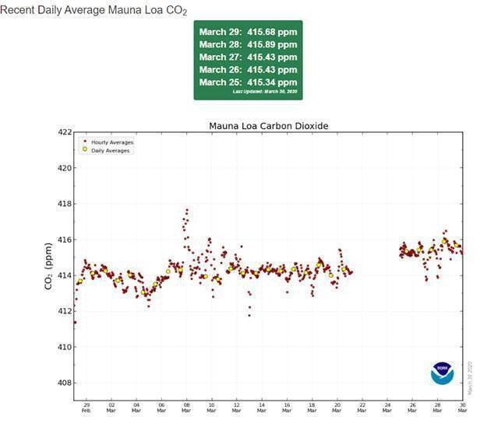
Mauna Loa fraud
The Department of Commerce Office of Inspector General (OIG) has received your correspondence and reviewed the information you provided. We have assigned complaint number 20-0641.
After the analyzer was “fixed” NOAA Mauna Loa CO₂ data Increased by exactly 1.500ppm

Slide 31
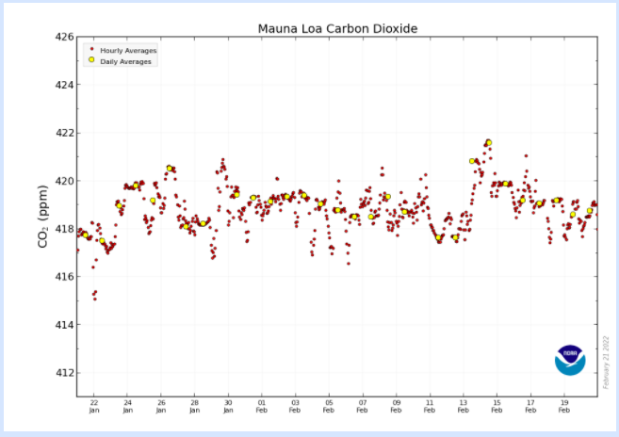
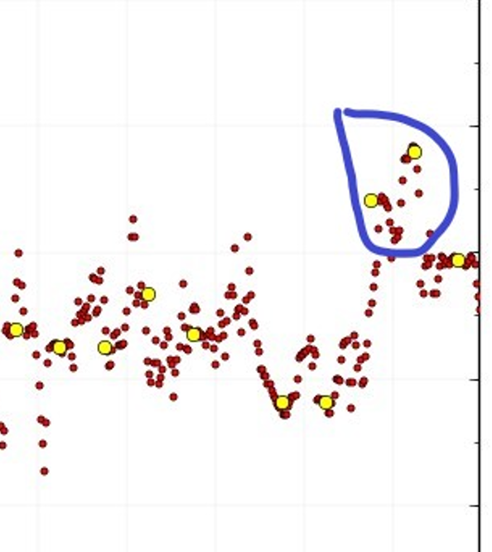
Mauna Loa more fraud

Slide 32
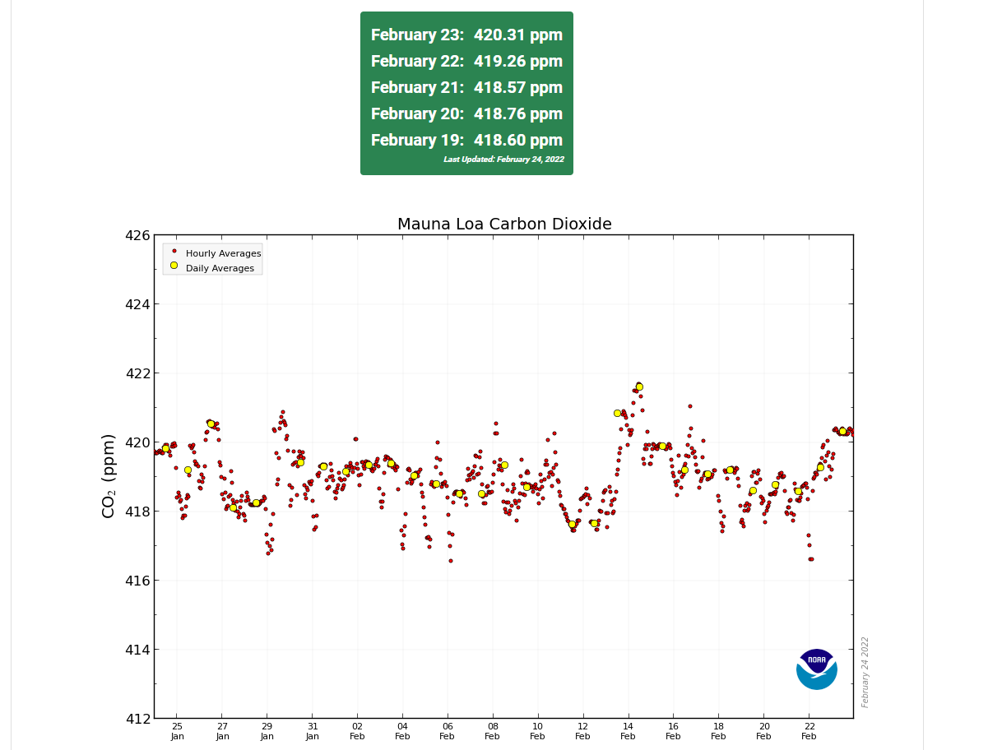
Mauna Loa more fraud
In the image below taken on 2/25/2022, it can be seen 3 yellow ball averages on
the right side.
Climate Change Truth (cctruth.org) has watched this daily. Never has there been 3
days in the same slope. The probability of this happening without collusion is
1/179³=1/5,735,339 or 1 time in 5,735,339 measurements.

Slide 33
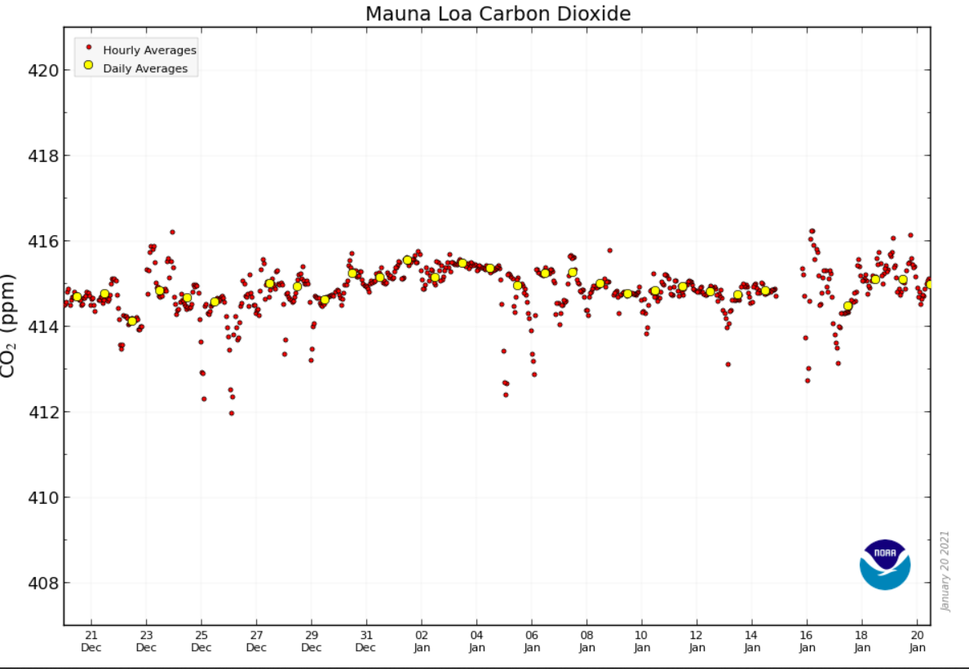
Peru Stopped Deforestation in December 2020

Slide 34
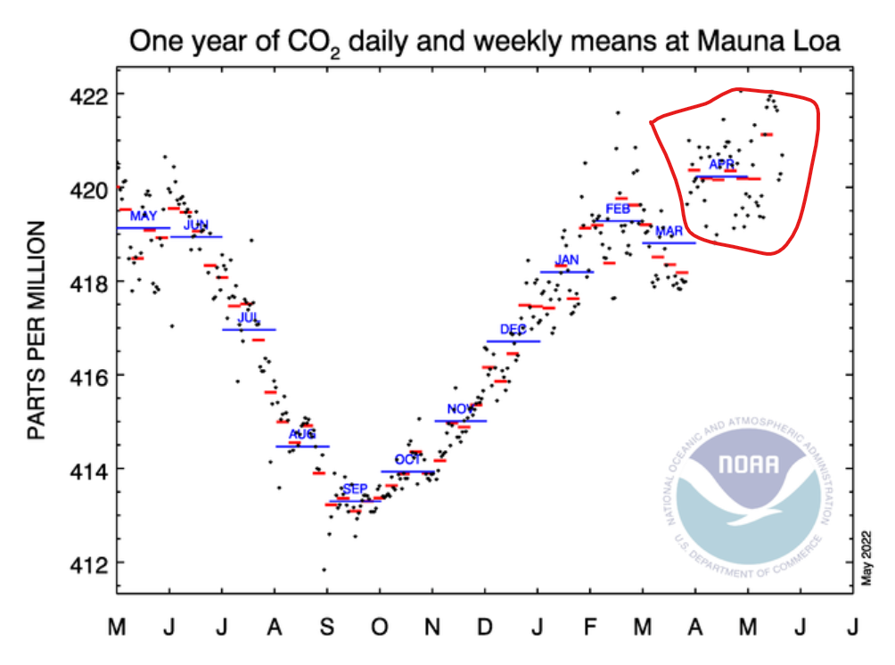
Mauna Loa CO2 Peak in February this year.
For 70 years Mauna Loa worldwide Carbon Dioxide peaked in late May and decreased until early November. However it peaked this year in February because of Indian Rainforest destruction stop, Peru stopping deforestation and 26+ billion trees planted since May 2018. The red enclosed area is fraud!

Slide 35
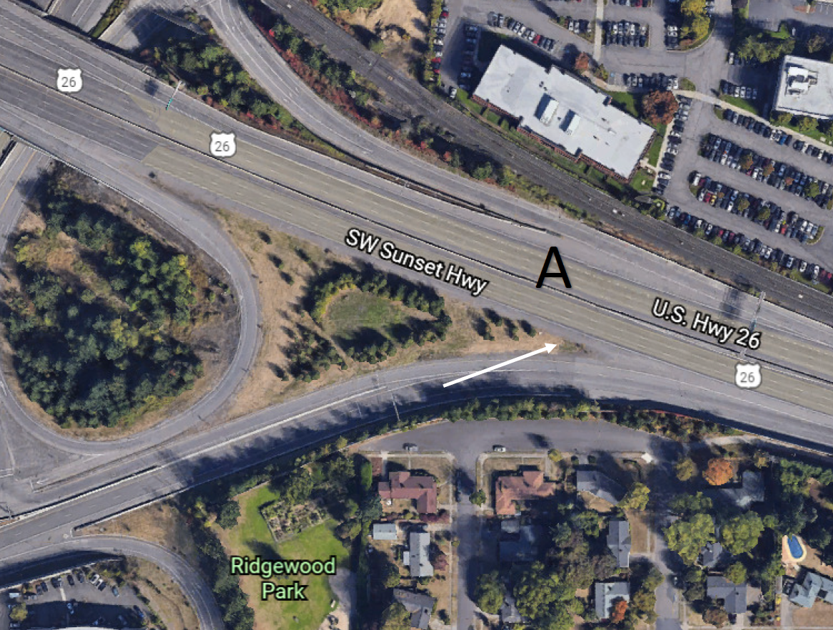
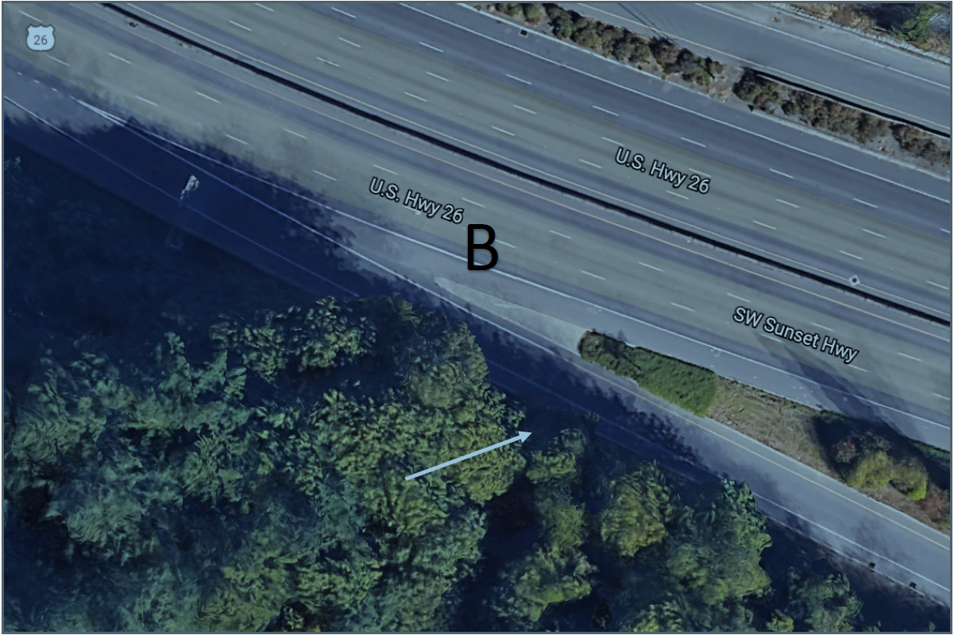
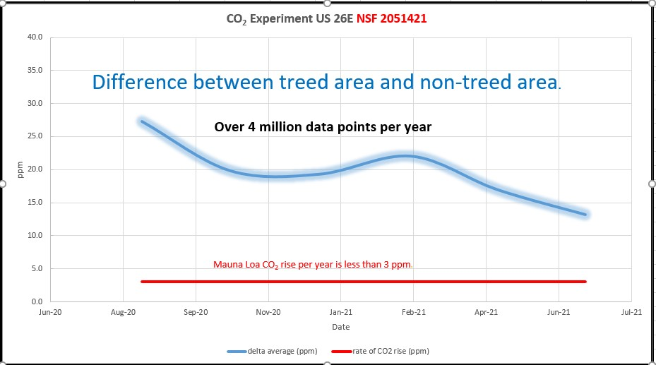
State of Oregon sanctioned experiment
Non treed area - treed area is 28 ppm lower carbon dioxide concentration! 15 ppm difference in December!
NIST Certified CO₂ sensors calibrated within 1 ppm.
Scientific Law achieved!
The non-treed area sensor is consistently
394-494 for 46 degrees north. The NOAA
graph predicts 416 ppm! This is far outside
that prediction.
160k vehicles per day
  6CO₂+ 6H₂O + λ -> C₆H₁₂O₆ + 6O₂

Slide 36
Tweet to Amazon leaders
@jairbolsonaro @MartinVizcarraC @alvorada_palace, @MichelTemer @Peru @IvanDuque @evoespueblo @MashiRafael @MOTPGuyana @govsuriname @maduro_en @Lenin
Stop Deforestation NOW! Peru stopped last December! https://riotimesonline.com/brazil-news/rio-politics/stop-amazon-rainforest- deforestation-sponsored/
https://cctruth.org/rainforest-stop.pdf
On Facebook connect to Climate Change Truth and watch and share the posts.

Slide 37
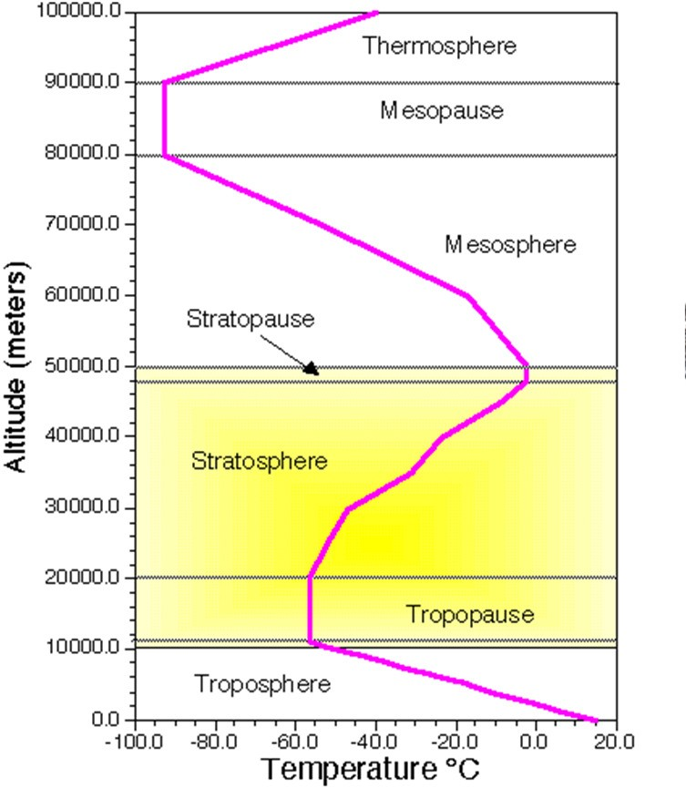
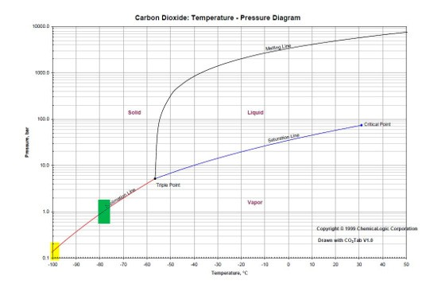
CO₂ does not freeze in Mesosphere
Pressure in Mesosphere is 1mb (1 millibar)

Slide 38
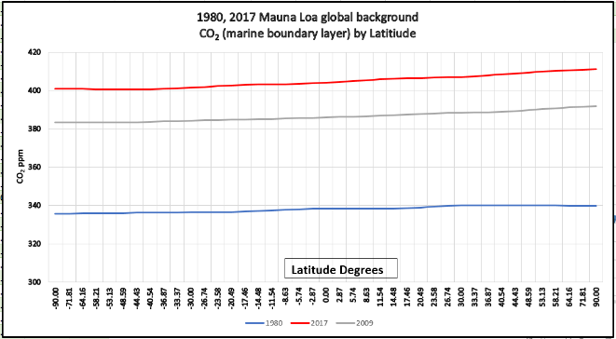
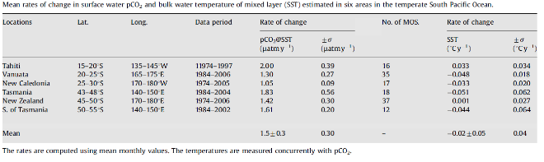
Ocean is not a sink for Atmospheric Carbon Dioxide
Diffusion flux =-D(ΔC/ΔX)
  Movement (not necessarily random) from high concentration to lower concentration. Example: diffusion of carbon dioxide is 2 cm/month toward
  the exosphere. Not toward the ocean. The ocean is not a sink for CO₂

Slide 39
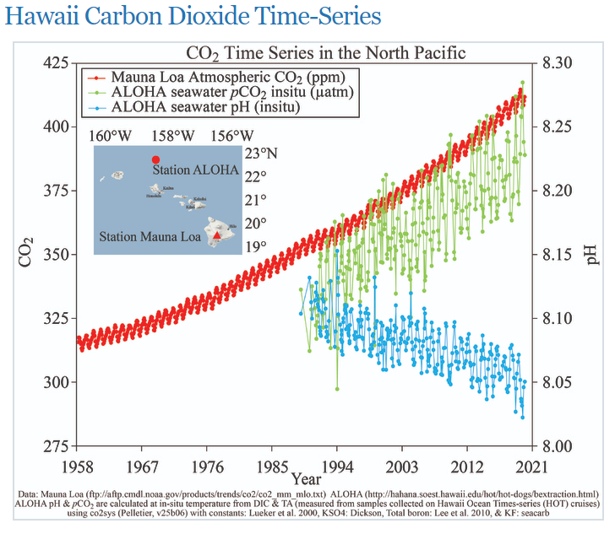
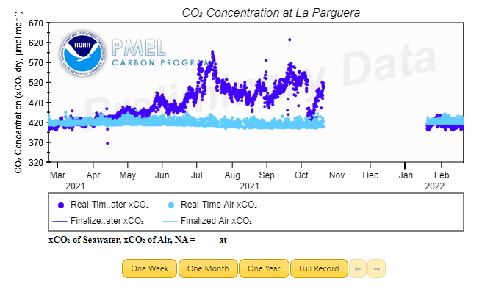
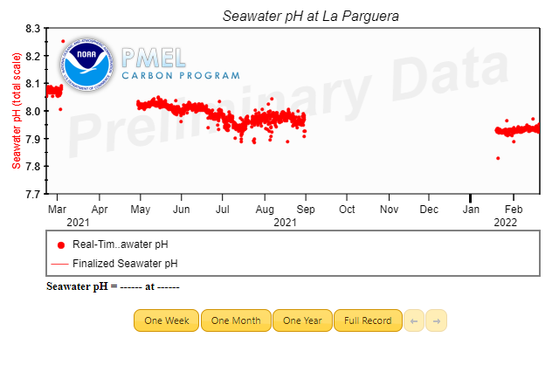
Ocean is not a sink for Atmospheric Carbon Dioxide
La Parguera Mooring (17.95°N, 67.05°W) No change in CO2 or ph.
https://www.pmel.noaa.gov/co2/story/OA+Observations+and+Data

Slide 40
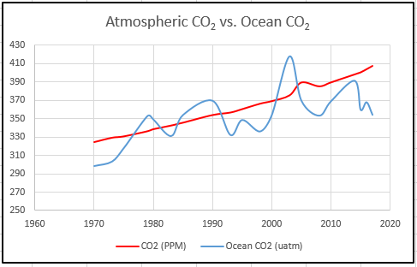
Ocean is not a sink for Atmospheric Carbon Dioxide
SOCAT data is from vessels with carbon dioxide sensors.
The spreadsheet has all the data for the past 50 years.
No correlation between tropospheric CO₂ and ocean CO₂.
Rxy=0.65

Slide 41
Intergovernmental Panel on Climate Change
The Intergovernmental Panel on Climate Change reports are inaccurate and are falsely skewing Data. https://cctruth.org/ipcc.pdf Publishing garbage manuscripts in a journal whose chief editor that has a degree in Political Science. Is not science.
Review of:
    SR 1.5 Chapter three “Mitigation” garbage
      Atmospheric CO2 equilibrium statement had zero citations to any published manuscript.
      The actual equilibrium is 8.6 gt/yr.
      Their only probability for their solution to work by lowering emissions of CO2 is 50-66%. Would you take your car to a mechanic who said they could fix it 50-66% of the time?
http://www.theenergynet.com/2020/06/one-mans-fight-to-end-deforestation-one- tree-at-a-time/

Slide 42
Intergovernmental Panel on Climate Change
Limiting warming to 1.5°C depends on greenhouse gas (GHG) emissions over the next decades, where lower GHG emissions in 2030 lead to a higher chance of keeping peak warming to 1.5°C (high confidence). Available pathways that aim for no or limited (less than 0.1°C) overshoot of 1.5°C keep GHG emissions in 2030 to 25–30 GtCO2e yr−1 in 2030 (interquartile range). This contrasts with median estimates for current unconditional NDCs of 52–58 GtCO2e yr−1 in 2030. Pathways that aim for limiting warming to 1.5°C by 2100 after a temporary temperature overshoot rely on large-scale deployment of carbon dioxide removal (CDR) measures, which are uncertain and entail clear risks. In model pathways with no or limited overshoot of 1.5°C, global net anthropogenic CO2 emissions decline by about 45% from 2010 levels by 2030 (40–60% interquartile range), reaching net zero around 2050 (2045–2055 interquartile range).
For limiting global warming to below 2°C with at least 66% probability CO2 emissions are projected to decline by about 25% by 2030 in most pathways (10–30% interquartile range) and reach net zero around 2070 (2065–2080 interquartile range). {2.2, 2.3.3, 2.3.5, 2.5.3, Cross-Chapter Boxes 6 in Chapter 3 and 9 in Chapter 4, 4.3.7}

Slide 43
Intergovernmental Panel on Climate Change
    Working Group I Second Order Draft for Ar6
      The scientific consensus is 33% not 97%
      IPCC GWP (Global warming potential) is false because it assumes equal concentrations of GHG. CO₂ is 419 ppm CH₄ is 1.9 ppm and so on.
      Sea level rise is 1.4 mm/yr and not accelerating. The Jakobshavn Glacier in Greenland has grown for the third year in a row.
      Residence time. In a 2003 report, the IPCC said it was from 5-200 years. Average residence time is 150 years.

Slide 44
Intergovernmental Panel on Climate Change
Working Group II First Order Draft for Ar6
  Netflix watch “Kiss the ground” movie explains even if we stopped all CO2 emissions atmospheric CO2 will not lower.
  Use of Unscientific Terms. The document uses the unscientific terms highly (or otherwise) likely six times, unlikely three times, and highly (or otherwise) confident sixty-two times.
  The graph they use to say cause and effect for emissions vs. CO₂ rise has not been updated since 2012. After 2014 worldwide emissions were mostly flat, with a 7% drop last year.

Slide 45
Global Warming Potential
IPCC Global warming potential is a false calculation!
  Assumes equal Greenhouse Gas concentrations. Not based in reality!
Dr. T. J. Blasing of Oak Ridge National Laboratory exposed greenhouse gasses to long wave radiation.
Gas (Watts/m²)
CO2 ppm.
CH₄ Methane ppb.
O₃ (Ozone)
N2O Nitrous Oxide ppb
The remainder are negligible.
https://cdiac.ess-dive.lbl.gov/pns/current_ghg.html?fbclid=IwAR1u1m3z1xjRUebekpHruu5gXnaZ0CTicuG0gGcgw1Ph855sbZ41A5tcg7E
Increased radiative forcing
1.94
0.50
0.40
0.20

Slide 46
Supreme Court decision against the EPA.
The Clean Air Act of 1967 directed the EPA to tackle such issues as Acid Rain and others.
It instructs the EPA to make a “toxic chemicals” list.
the EPA wants to regulate in Section 111 subsection d must be on the toxic chemicals list. The EPA in 2015 illegally used section 111 subsection d to go after greenhouse gases without putting them on the toxic chemicals list.
Carbon dioxide, methane etc. are not toxic and therefore could not be put on the list. Congress must start a congressional investigation and put the people who did this on trial. If congress wants the EPA to regulate Greenhouse gases, then it needs to write another law. However, they need to keep the following scientific facts in mind when writing such legislation.

Slide 47
Georgia Tech in 2012 exposed Greenhouse gases
Table 7.2 page 3 of http://irina.eas.gatech.edu/EAS8803_SPRING2012/Lec7.pdf
Calculating percent effect is for water vapor 303.8/344.2*100=88.26%
The 339.8 is the sum of these effects.
Water vapor is 89.4% ghg effect.
Carbon dioxide is 9.09%
Ozone is 0.88%
Nitrous Oxide is 0.32%
Methane is 0.29%
Greenhouse Gas | Emission band cm⁻¹ | Radiation Flux W/m²
H2O Water vapor | All bands | 303.8
CO2 Carbon dioxide | All bands | 30.9-37.3
CH4 Methane | 1200-1400 | 1.0-1.2
N2O Nitrous Oxide | 1200-1300 | 1.1-1.3
O3 Ozone | 900-1100 | 3.0-3.3

Slide 48
Sea-Level Rise
Dedicated to Tom W. http://colderside.com/ who passed away June 29th, 2021
Tide Gauges & Satellites
  Different Linear Measures Inconsistent Results
  Apparently Unaffected by Recent CO₂ Increases

Slide 49
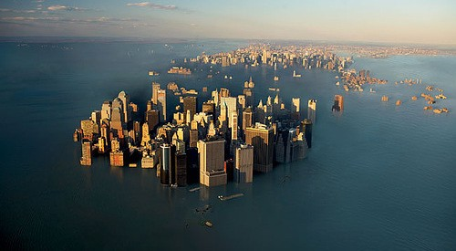
The Future for NYC? NO

Slide 50
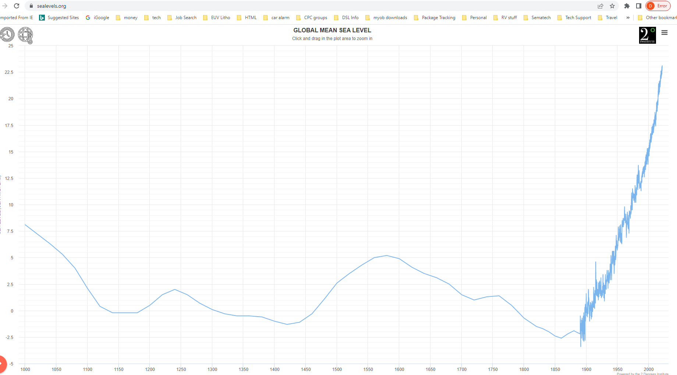
Two different measurement systems.

Slide 51
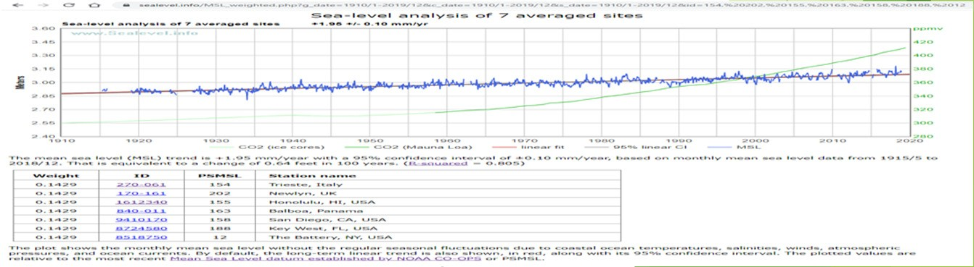
II-Ocean Sea level rise is linear and not accelerating!
No reliability in NOAA Sea level measurement's
The NOAA satellite; Jason-3 has a minimum resolution of 25 mm.
  This is like using a yardstick with no gradations and putting an unfamiliar object 20 feet away and then performing measurement's. The data would not be reliable.
The Jakobshavn Glacier in Greenland has grown for the third year in a row. https://earthobservatory.nasa.gov/images/145185/major- greenland-glacier-is-growing

Slide 52
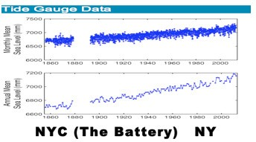
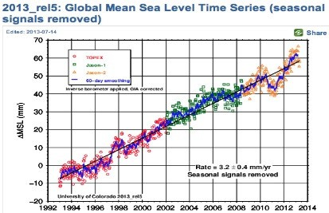
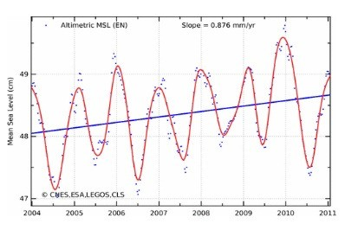
World Sea-Level rise
3 Sources – Different Metrics
Tide Gauges 1.4mm/yr.
Topex/Poseidon/ 3.3mm/yr. Jason 1 - 3
Linear
Linear
ENVISAT
0.5 – 2.5mm/yr.
Linear

Slide 53
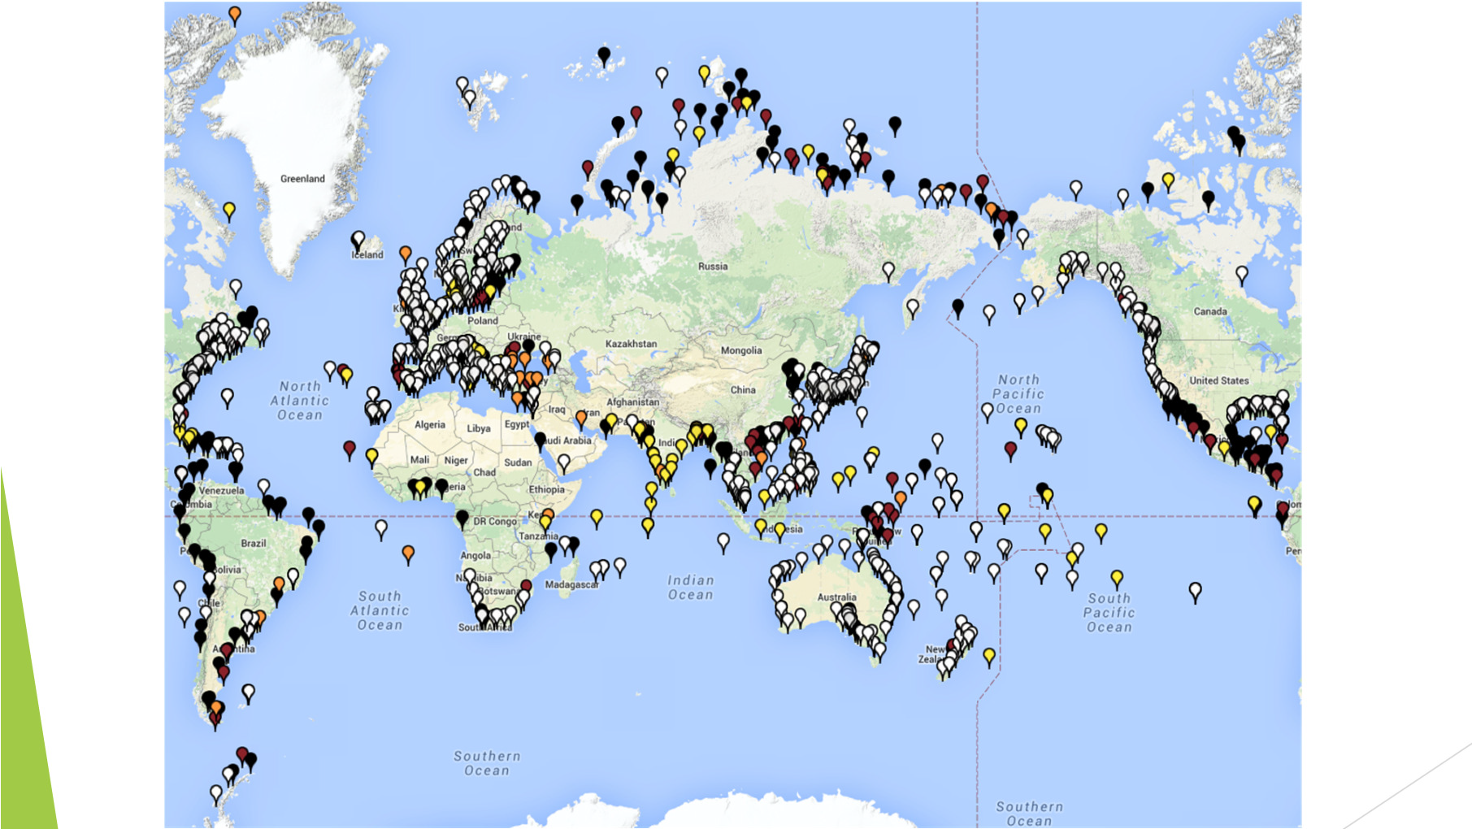
Tide Gauge Distribution

Slide 54
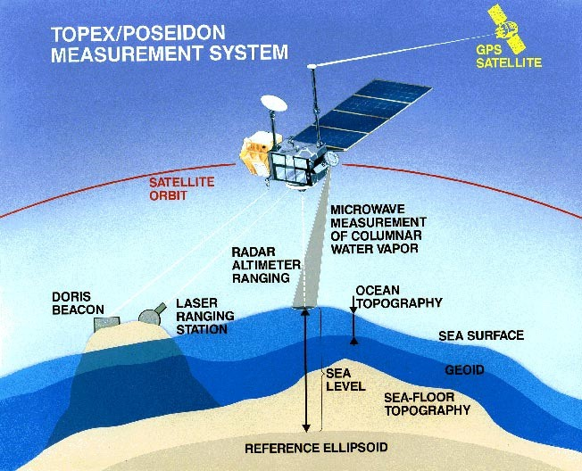
Satellite Systems

Slide 55
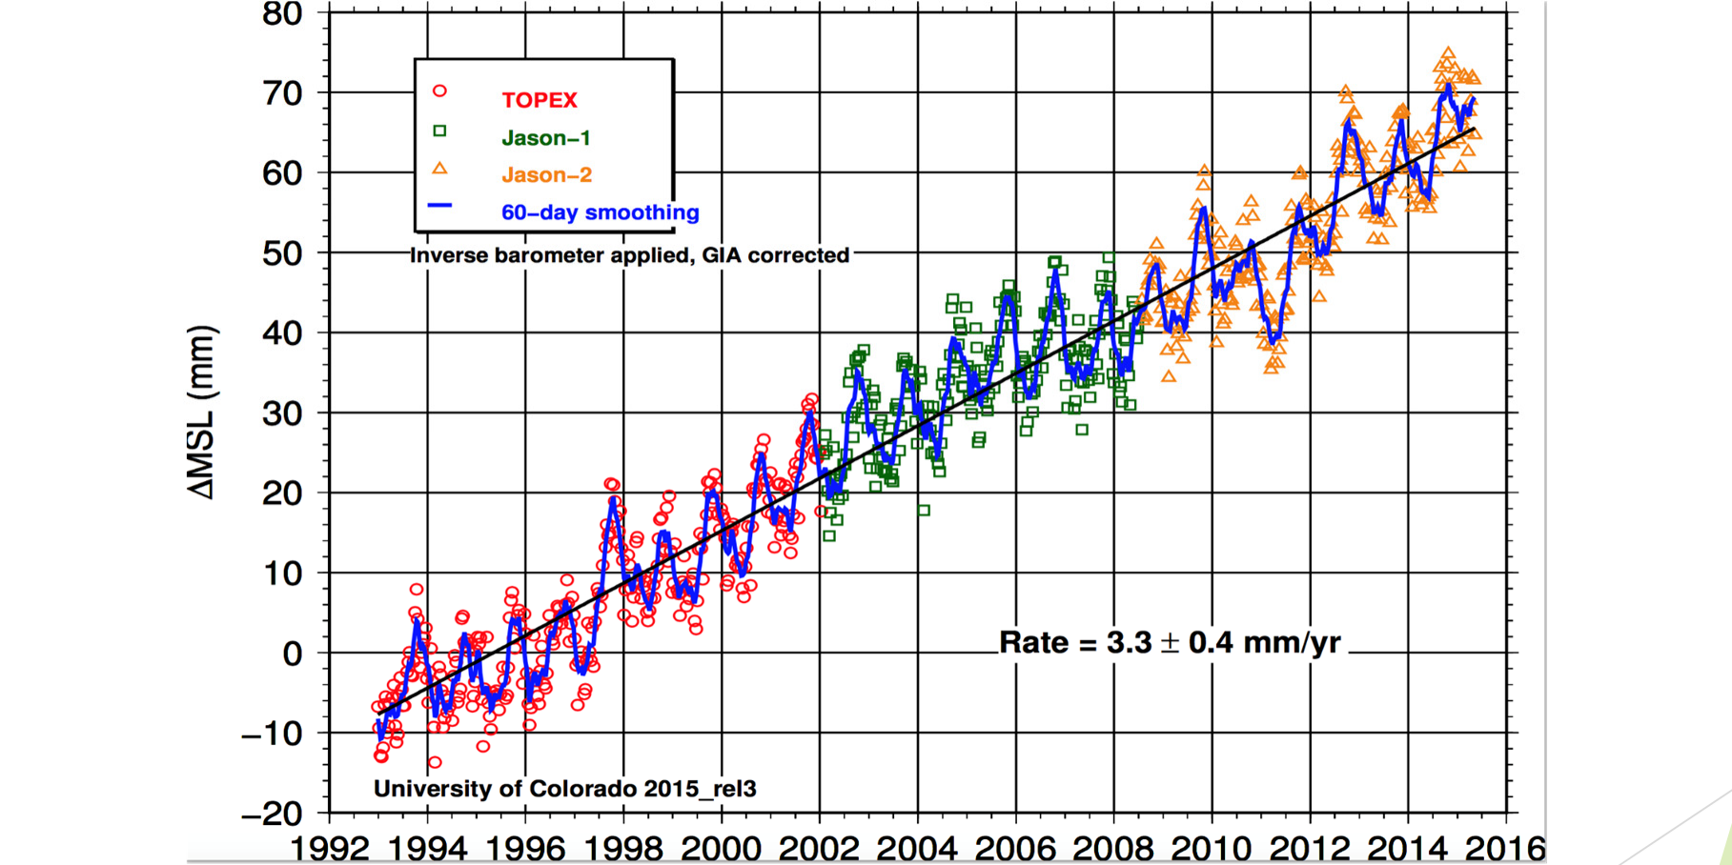
Satellite [Adjusted]

Slide 56
Topex/Poseidon Specifications
Altitude 1335KM [830 Mi] Radar Resolution
Ku-Band C-Band
13.65 GHz
5.3
23 mm wavelength
GHz
56 mm wavelength
Orbital Tracking Error
20 – 40 mm

Slide 57
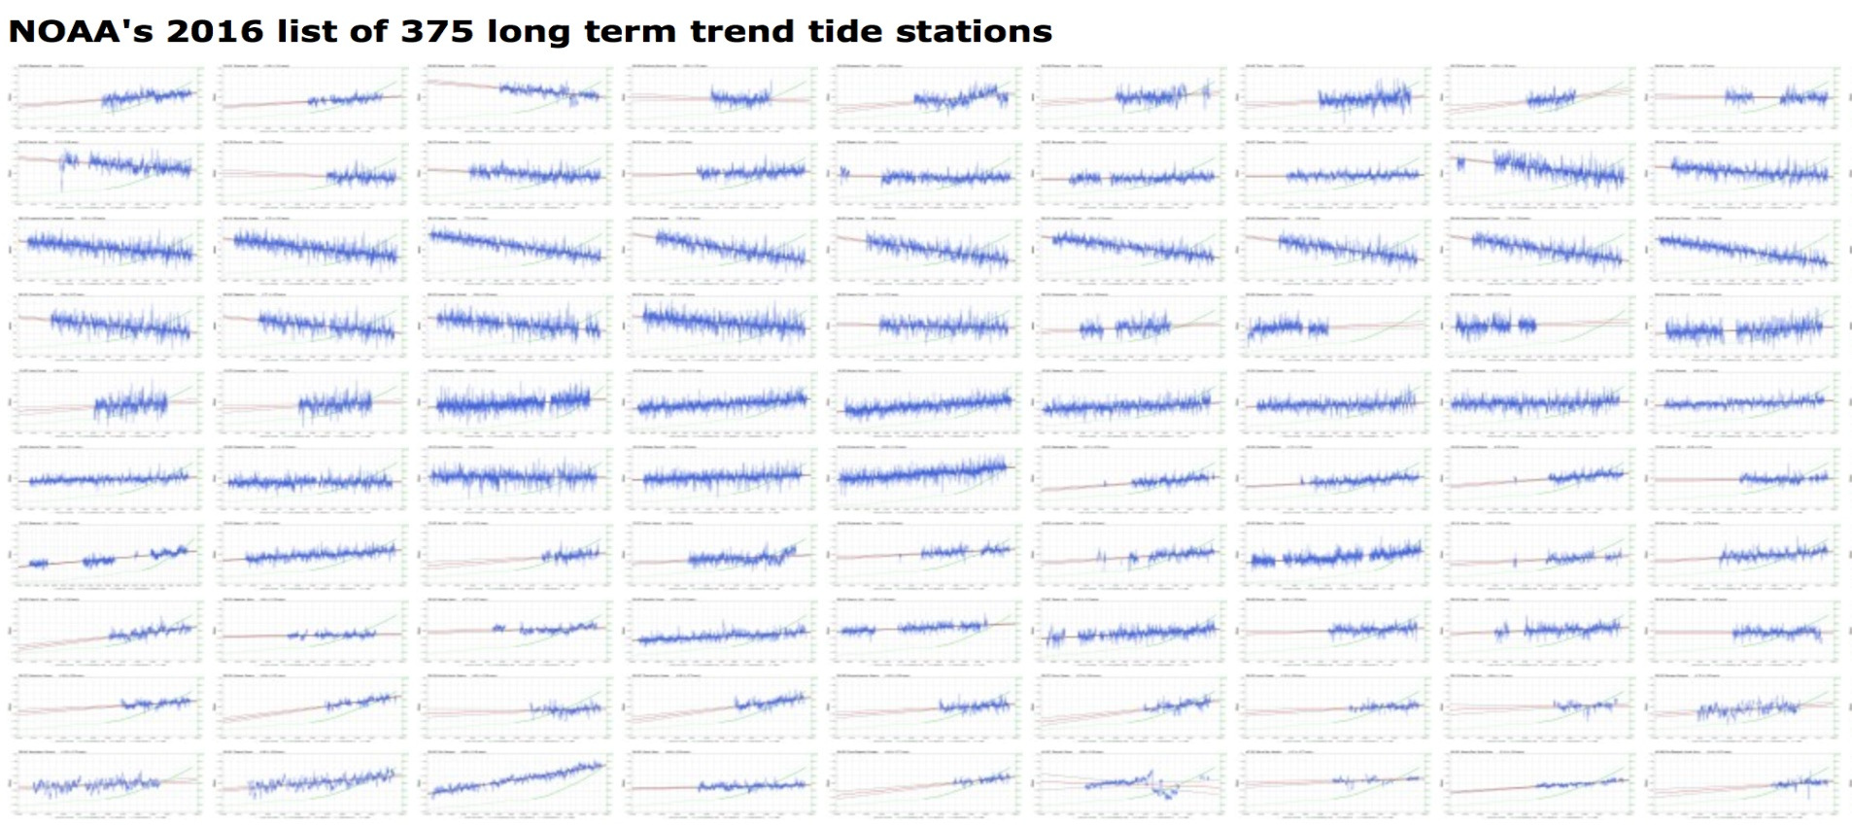
Massive 38% CO₂ Increase Since 1880
Any sign of Sea-Level Rise Acceleration?
  They’re all Linear

Slide 58

NiCE fix for SE storms Conor Mcmenemie mcmenemieconor@hotmail.com
For millions of years a warm, shallow, opaque, 26,000 km², fresh water lake would appear in the north eastern Sahara Desert from July to October.
This was created by the torrent of water flowing down the River Nile into modern day Egypt, submerging the flood plains and delta under up to 8 meters of water.
This lake created clouds which cooled the western Africa shore water.
Storms in the SE USA originate from this water.

Slide 59
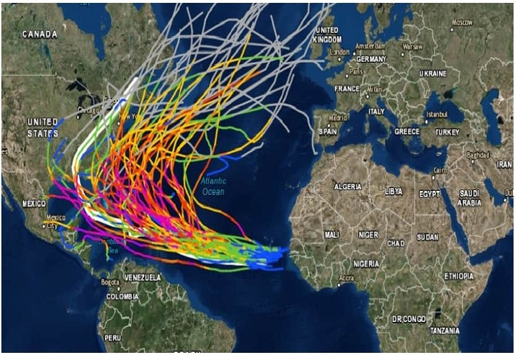
SE USA storm track
The warmer the water off the coast of Africa the further west the hurricanes go. Prior to 1970 (When the Aswan Dam was built) the water was cooler. Most storms went straight up the Atlantic ocean.

Slide 60

It needs to be emphasised that the historic moisture flux from the July to October Nile flood is completely missing from ALL research and literature, yet it was an essential component of the planet's second largest weather system

Slide 61

Shallow water heats faster
More surface area evaporation from shallow water than deep water.

Slide 62

Sahelian August Rainfall change
Less and less rainfall from clouds every year.
This because no flooded area.

Slide 63

Storm Track Again

Slide 64
The NiCE Chain Reaction
The NiCE Chain Reaction
Nile Flood
. . . .
Evaporation onto Ethiopian Highlands
. . . .
Kiremt rainfall event
. . . .
African Easterly Waves
. . . .
Equatorial Atlantic marine stratocumulus cloud
. . . .
Summer Sea Isolation
. . . .
Ocean Heat Transport
. . . .
Additional heat released into Atmosphere
. . . .

Slide 65



Results

Slide 66
Summary
Atmospheric CO₂
  Not caused by carbon dioxide emissions. Little effect.
  Caused by massive loss of photosynthesis. Mainly Amazon Rain-forest. Trees release Terpenes which induce rain!
  Does not freeze in upper atmosphere.
  Sea Level rise is not accelerating.
  NiCE fix for storms. Better Dam management needed.
  There is nothing green in the green new deal unless you like rolling blackouts! Solar panels don’t work at night or with snow on them. Windmills are not the solution https://www.youtube.com/watch?v=JYHX-Ib3Q5Q
  India and China need to remove lead from gasoline and install pollution mitigation equipment on their factories.
  College Textbook for Environmental science on cctruth.org
  Contact Data
    research@cctruth.org 503-608-7611

Slide 67
Acknowledgments
International Journal of Chemical Engineering
International Journal of Environmental Science and Development
This conference
Your kind attention
Huge Tree planting Event Earth Day 2023!

